Slide 1
Mercedez Benz Greener Manufacturing
By
Faizanuddin Siddique

Slide 2
AIM
To Reducing testing time of vehicles in Mercedes Benz test bench
Notes:
To ensure the safety and reliability of every unique car configuration before they hit the road, Daimler's engineers have developed a robust testing system. But, optimizing the speed of their testing system for so many possible feature combinations is complex and time-consuming without a powerful algorithmic approach.
Keeping the above problems in context our aim in this project is to reduce vehicle testing time on the testing bench by taking into consideration testing parameters and features.

Slide 3
The Solution
While predicting testing of vehicles features such as X205, X106, X113, X190, X25, X215, X242, X101, X243 are having maximum impact and can be focused more in order to reduce testing time of vehicles.
Notes:
My proposed solution is to concentrate on features having max impact on vehicle timing.

Slide 4
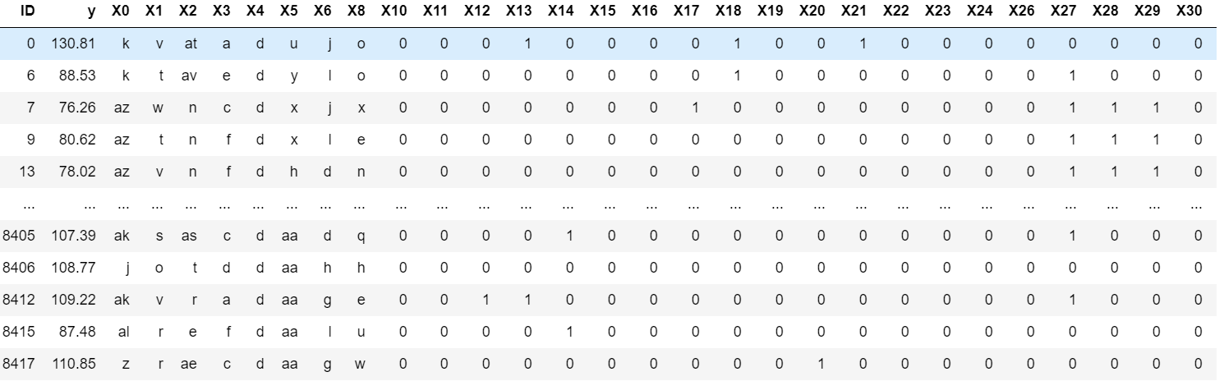
The Data
Data Source: https://www.kaggle.com/c/mercedes-benz-greener-manufacturing/data
Notes:
Dataset was 4209 rows and 378 columns

Slide 5
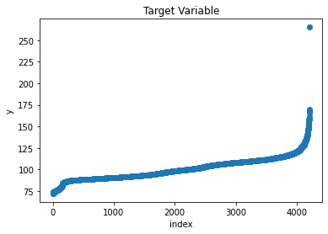
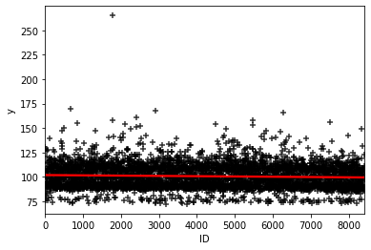
Target Variable Distribution
Notes:
For the target variables we are using value where y <160 seconds after removing outliers .
Also our observation shows how target variable is changing slightly with respect to ‘ID’ which shows that tests may be sequential.

Slide 6
Feature Engineering
There were no missing values in the given dataset.
There were no duplicate rows but there were 56 duplicate columns, these columns were dropped for the analysis.
Categorical features ‘X4’ was having a min variance with majority values as ‘d’ hence this column was dropped.
For numerical features having variance as 0 were dropped.
Correlation matrix for numerical features was computed features correlating greater than 0.95 exhibited multicollinearity hence these features too were dropped.
After the above steps, there were still 292 features present.
Categorical variables were ordinal and hence label encoded, one hot encoding was initially applied but this led to an increase in dimensions and also lead to a decrease in model predictive power.
Similar feature engineering steps were applied for the test data having 4209 observations.
All the features were scaled using a standard scalar.
Validation data was formed using training data by keeping split as 30:70.
PCA with 2 components was used to further reduce the dimensionality on training test and validation datasets.
R2 score was selected as evaluation metric.
We need to predict testing time for the given test data and submit it in Kaggle kernel for getting public score for the competition.

Slide 7
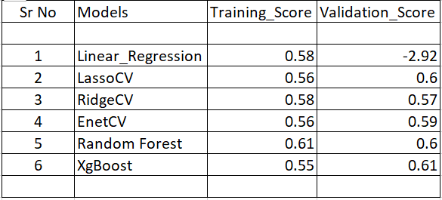
Model Performance
Model Selection
Linear Regression
LassoCV
Ridgecv
EnetCV
Random Forest Regressor
XGBoost Regerssor
Notes:
Metric used was R2 score.

Slide 8
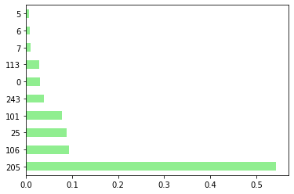
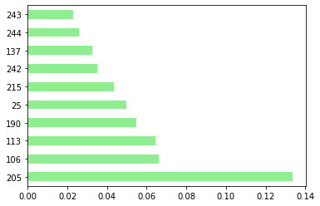
Feature Importances
Random Forest
Xgboost
Notes:
While predicting testing of vehicles features such as X205, X106, X113, X190, X25, X215, X242, X101, X243 are having maximum impact and can be focused more in order to reduce testing time of vehicles.

Slide 9
Hyperparameter Tuning
R2 score Increased by
Random Forest: 0.58 to 0.6o
Xgboost : 0.55 to 0.61
5 fold Grid Search Cross Validation
Notes:
Tuned Parameters for Random Forest : {'max_depth': 5, 'min_samples_leaf': 10, 'min_samples_split': 10, 'n_estimators': 50}
Tuned Parameters for Xgboost :{'colsample_bytree': 0.7,'learning_rate': 0.01,'max_depth': 3,'min_child_weight': 1,'n_estimators': 500,'objective': 'reg: squared error',' subsample': 0.7}

Slide 10
Takeaways
XGBoost was best model
While predicting testing of vehicles features such as X205, X106, X113, X190, X25, X215, X242, X101, X243 are having maximum impact
A lot of features are not important (Reduced columns from 378 to 292)
Notes:
After Submission of the predicted Target value in Kaggle we have got test Public score of 0.54751.

Slide 11
Future Research
For categorical variables to get better sense Mean encoding can be used or extra features can be created to get better inference.
Instead of using standard scalar model vector normalization can be used.
Further to increase the predictive power of our models we can use ensemble techniques such as stacking and blending

Slide 12
Thank You!
Mercedez Benz for making data avalaible on kaggle
Springboard Team for guidance throught
Devesh Raj for guidance during project

Slide 13
Questions?

